Slide 1
Amalgamations
&
Restructuring

Slide 2
Recap: Business valuation , WACC, capital Structure & NPV
Net Present Value (NPV)/
Internal Rate of Return (IRR)

Slide 3
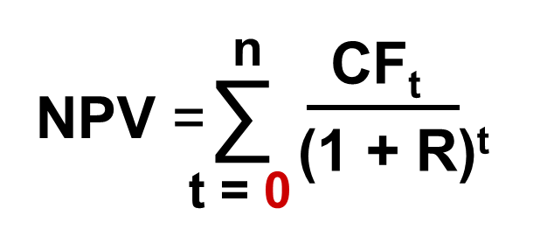
You are looking at a new project and have estimated the following cash flows:
  Year 0: CF = -165,000
  Year 1: CF = 63,120
  Year 2: CF = 70,800
  Year 3: CF = 91,080
Your required return for assets of this risk is 12%. Determine the NPV of the Project

Slide 4
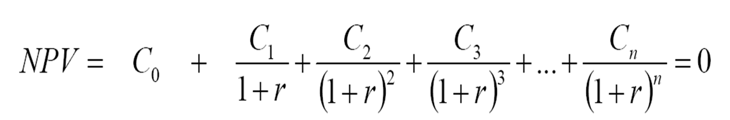
Internal Rate of Return (IRR)
  IRR is simply the discount rate at which the NPV of the project equals zero.
  You can calculate the rate of return on a project by:
    1. Setting the NPV of the project to zero.
    2. Solving for “r”.
  Unless you have a financial calculator, this calculation must be done by using trial and error!

Slide 5
Cost of Capital & WACC
Cost of capital components
  Debt
  Preferred stock
  Common equity
Application
Min Req’d return needed on Project
Reflects blended costs of raising capital
Relevant “i ”
Discount rate used to determine Project’s NPV or to
Hurdle rate

Slide 6
Weighted Average Cost of Capital (WACC)
WACC: Blended cost or raising capital considering mix of debt & equity
WACC = (Wt of Debt)(After-tax cost of Debt) + Wt of Eqty)(Cost of Eqty) + (Wt of Prfd)(Cost of Prfd)

Slide 7
Recap: Business valuation , WACC, capital Structure & NPV
Business Valuation
Why?
  Quoted companies- Merger or takeover bid( determine the fair offer price
  Unquoted companies
    The company wish to go public
    Merger
    To sold
    Other: When there is MBO

Slide 8
Valuation of listed companies
Market Capitalization
  market value of a company's outstanding shares.
  Generally current market price is used for base figure
Valuation of listed companies
Does not have stock market price
Determining the value is difficult

Slide 9
Different valuation techniques
Asset Valuation bases
Earning valuation basis
  P/E ratio method of valuation
  The earning yield valuation method
  ARR method
  Dividend valuation basis
Cash Flow valuation basis
  Discounted future cash flow basis
  Free cash flow method

Slide 10
Cash Flow valuation basis
Free Cash Flow Valuation
Free cash flow valuation is an approach to business valuation in which the business value equals the present value of its free cash flow. It involves projecting free cash flows into future and then discounting them at the appropriate cost of capital.
Formula
The most basic free cash flow valuation models are similar to the dividend discount model. The following formulas are using to calculate business value and business equity value respectively:
Total Business Value (under FCFF model) = FCFF Next Year
WACC − g
Equity Value Under FCFF Valuation Model = Total Business Value − Market Value of Debt
Business Equity Value (under FCFE model) = FCFE Next Year
r − g

Slide 11
Operating free cash flow = Revenues
              -operating cost
              + Deprecation
              Debt payments
              Working capital increase/+ WIC decrease
              Taxes
              Capital expenditure

Slide 12
Asset Valuation bases
Asset base is mostly used to determine minimum value which can be useful for business is difficult to sell.
Basis: Value per share : Net tangible assets*
No of shares
* Intangible assets should be excluded unless it has mkt value

Slide 13
Ex: Summary of the statement of financial position of A company are as follows
No of shares 100,000 & determine the value of the company
Non current asset |  |  | Rs,000
 | PPE |  | 150,000
 | ood Will |  | 50,000
Current asset
 | Inventory |  | 60,000
 | Trade Receivables |  | 20,000
 | Cash |  | 8,000
Ordinary shares |  |  | 120,000
Reserves |  |  | 30,000
Preference shares |  |  | 50,000
Debentures |  |  | 40,000
Current liabilities
 | Payables |  | 22,000
 | Dividend payables |  | 16,000
 | Tax payable |  | 10,000

Slide 14
Earning valuation basis
P/E ratio method
PE ratio relates earning per share to shares value
PE Ratio = | MPS
 | EPS
Then
MPS= | EPS x PE ratio

Slide 15
Earnings yield valuation (EY)
EY = EPS x 100
MPS
Then’ MPS= Earning/ EY
Accounting rate of return (ARR) method
Value= Estimate future profit
Required return on capital
i.e
“A” company expected to acquire “ B” Company, avg earnings 100Mn. HW after acquisition , “ A” company expect that “ B “ company earnings will increase to 150Mn. Also they expect 10% of capital employed. Determine the “ B” company value

Slide 16

Dividend Valuation basis
The Dividend Discount Model (DDM) is a method to estimate the value of a share of stock by discounting all expected future dividend payments. The basic DDM equation is:
In the DDM equation:
  P₀ = the present value of all future dividends
  D_{t} = the dividend to be paid t years from now
  k = the appropriate risk-adjusted discount rate
i.e
Suppose that a stock will pay three annual dividends of Rs. 200 per year, and the appropriate risk-adjusted discount rate, k, is 8%.

Slide 17
The Dividend Discount Model: the Constant Perpetual Growth Model
Assuming that the dividends will grow forever at a constant growth rate g.
For constant perpetual dividend growth, the DDM formula becomes:
In 2017, the dividend paid by the utility company, ABC PLC, was Rs 2.12.
Required rate of return of ABC share holders is 10% . & expect earning will grow at 3% . Determine the value of stock

Slide 18
The Sustainable Growth Rate
Return on Equity (ROE) = Net Income / Equity
Payout Ratio = Proportion of earnings paid out as dividends
Retention Ratio = Proportion of earnings retained for investment

Slide 19
Shareholder value Analysis
Value creation using NPV approach
Shareholder value is the total return to shareholders in terms of both dividend & capital gain , calculated as present value of future free cash flows of the entity discounted at the WACC of the entity less market value of debt

Slide 20
The Two-Stage Dividend Growth Model
The two-stage dividend growth model assumes that a firm will initially grow at a rate g1 for T years, and thereafter grow at a rate g2 < k during a perpetual second stage of growth.
The Two-Stage Dividend Growth Model formula is:
i.e. ABC Plc ., has been growing at a phenomenal rate of 20% per year. You believe that this rate will last for only three more years. Then, you think the rate will drop to 10% per year. Total dividends just paid were 5 million.
The required rate of return is 20%.
What is the total value ABC PLC

Slide 21
Shareholder value Analysis

Slide 22
i.e
“A” Plc forecast operating profit of 160Mn, after deduction of 10Mn deprecation , Taxation for the year estimated to be 48Mn. Share holders require rate of return 10% . There will be sold of PPE 20Mn. Last year WIC 100 Mn & this year it will be 150Mn. It is estimated that the FCEF next years will be constant
Determine the value of A Plc

