Slide 1
Standard Costs and Operating Performance Measures
Notes:
Chapter 11: Standard Costs and Operating Performance Measures
This chapter extends our study of management control by explaining how standard costs are used by managers to control costs. It demonstrates how to compute direct materials, direct labor, and variable overhead variances. The chapter also defines some nonfinancial performance measures that are frequently used by companies.

Slide 2
Standard Costs
Standards are benchmarks or “norms” for
measuring performance. In managerial accounting,
two types of standards are commonly used.
Quantity standards
specify how much of an
input should be used to
make a product or
provide a service.
Price standards
specify how much
should be paid for
each unit of the
input.
Examples: Firestone, Sears, McDonald’s, hospitals,
construction and manufacturing companies.
Notes:
A standard is a benchmark or “norm” for measuring performance. In managerial accounting, two types of standards are commonly used by manufacturing, service, food and not-for-profit organizations:
Quantity standards specify how much of an input should be used to make a product or provide a service. For example:
Auto service centers like Firestone and Sears set labor time standards for the completion of work tasks.
Fast-food outlets such as McDonald’s have exacting standards for the quantity of meat going into a sandwich.
Price standards specify how much should be paid for each unit of the input. For example:
Hospitals have standard costs for food, laundry, and other items.
Home construction companies have standard labor costs that they apply to sub-contractors such as framers, roofers, and electricians.
Manufacturing companies often have highly developed standard costing systems that establish quantity and price standards for each separate product’s material, labor and overhead inputs. These standards are listed on a standard cost card.

Slide 3
Key performance indicators VS Actual performance
KPI/Pre cost target | Actual/Post cost | Variance
Direct material 10.00 per unit | 11.00 | 1.00 (A)
Direct labour 5.00 per unit | 5.50 | 0.50(A)
Variable overhead 2.00 per unit | 2.00 | -
Fixed overhead 1.00 per unit | 1.00 | -
Full cost 18.00 per unit | 18.50

Slide 4
Standard Costs
Deviations from standards deemed significant
are brought to the attention of management, a
practice known as management by exception.
Standard
Amount
Direct
Material
Direct
Labor
Manufacturing
Overhead
Type of Product Cost
Notes:
Management by exception is a system of management in which standards are set for various operating activities, with actual results compared to these standards. Any deviations that are deemed significant are brought to the attention of management as “exceptions.”
This chapter applies the management by exception principle to quantity and price standards with an emphasis on manufacturing applications.

Slide 5
Variance Analysis Cycle
Take
corrective actions
Identify
questions
Receive explanations
Conduct next period’s operations
Analyze variances
Prepare standard cost performance report
Begin
Notes:
The variance analysis cycle is a continuous process used to identify and solve problems:
The cycle begins with the preparation of standard cost performance reports in the accounting department.
These reports highlight variances that are differences between actual results and what should have occurred according to standards.
The Variances raise questions such as:
Why did this variance occur?
Why is this variance larger than it was last period?
The significant variances are investigated to discover their root causes.
Corrective actions are taken.
Next period’s operations are carried out and the process is repeated.

Slide 6
PDCA
P=PLAN
D=DO
C=CHECK
A=ACTION

Slide 7
Setting Standard Costs
Accountants, engineers, purchasing
agents, and production managers
combine efforts to set standards that encourage efficient future operations.
Notes:
Setting price and quantity standards requires the combined expertise of everyone who has responsibility for purchasing and using inputs. In a manufacturing setting, this might include accountants, engineers, purchasing managers, production supervisors, line managers, and production workers.
Standards should be designed to encourage efficient future operations, not just a repetition of past inefficient operations.

Slide 8
Setting Standard Costs
Should we use
ideal standards that
require employees to
work at 100 percent
peak efficiency?
I recommend using practical standards that are currently attainable with reasonable and efficient effort.
Engineer
Managerial Accountant
Notes:
Standards tend to fall into one of two categories:
Ideal standards can only be attained under the best of circumstances. They allow for no work interruptions and they require employees to work at 100% peak efficiency all of the time.
Practical standards are tight, but attainable. They allow for normal machine downtime and employee rest periods and can be attained through reasonable, highly efficient efforts of the average worker. Practical standards can also be used for forecasting cash flows and in planning inventory.

Slide 9
Setting Direct Material Standards
Price
Standards
Quantity
Standards
Final, delivered
cost of materials,
net of discounts.
Summarized in
a Bill of Materials.
Notes:
The standard price per unit for direct materials should reflect the final, delivered cost of the materials, net of any discounts taken.
The standard quantity per unit for direct materials should reflect the amount of material required for each unit of finished product, as well as an allowance for unavoidable waste, spoilage, and other normal inefficiencies.
A bill of materials is a list that shows the quantity of each type of material in a unit of finished product.

Slide 10
Setting Standards
Six Sigma advocates have sought to
eliminate all defects and waste, rather than continually build them into standards.
As a result allowances for waste and
spoilage that are built into standards
should be reduced over time.
Notes:
Six Sigma advocates argue that waste and spoilage should not be tolerated. If allowances for waste and spoilage are built into the standard quantity, the level of those allowances should be reduced over time.

Slide 11


Setting Direct Labor Standards
Rate
Standards
Time
Standards
Often a single
rate is used that reflects
the mix of wages earned.
Use time and
motion studies for
each labor operation.
Notes:
The standard rate per hour for direct labor includes not only wages earned but also fringe benefits and other labor costs. Many companies prepare a single rate for all employees within a department that reflects the “mix” of wage rates earned.
The standard hours per unit reflects the labor hours required to complete one unit of product. Standards can be determined by using available references that estimate the time needed to perform a given task, or by relying on time and motion studies.

Slide 12
Setting Variable Manufacturing Overhead Standards
Rate
Standards
Quantity
Standards
The rate is the
variable portion of the
predetermined overhead
rate.
The quantity is
the activity in the allocation base for predetermined overhead.
Notes:
The price standard for variable manufacturing overhead comes from the variable portion of the predetermined overhead rate.
The quantity standard for variable manufacturing overhead is expressed in either direct labor hours or machine hours depending on which is used as the allocation base in the predetermined overhead rate.

Slide 13
Price and Quantity Standards
Price and quantity standards are determined separately for two reasons:
The purchasing manager is responsible for raw
material purchase prices and the production manager
is responsible for the quantity of raw material used.
The buying and using activities occur at different times.
Raw material purchases may be held in inventory for a
period of time before being used in production.
Notes:
Price and quantity standards are determined separately for two reasons:
Different managers are usually responsible for buying and for using inputs. For example: The purchasing manager is responsible for raw material purchase prices and the production manager is responsible for the quantity of raw material used.
The buying and using activities occur at different points in time. For example: Raw material purchases may be held in inventory for a period of time before being used in production.

Slide 14
A General Model for Variance Analysis
Variance Analysis
Price Variance
Quantity Variance
Difference between
actual price and
standard price
Difference between
actual quantity and
standard quantity
Notes:
Differences between standard prices and actual prices and standard quantities and actual quantities are called variances. The act of computing and interpreting variances is called variance analysis.

Slide 15
A General Model for Variance Analysis
Variance Analysis
Price Variance
Quantity Variance
Materials price variance
Labor rate variance
VOH rate variance
Materials quantity variance
Labor efficiency variance
VOH efficiency variance
Notes:
Price and quantity variances can be computed for all three variable cost elements – direct materials, direct labor, and variable manufacturing overhead – even though the variances have different names as shown.

Slide 16
A General Model for Variance Analysis
Actual Quantity Actual Quantity Standard Quantity
× × ×
Actual Price Standard Price Standard Price
Price Variance
Quantity Variance
Notes:
Although price and quantity variances are known by different names, they are computed exactly the same way (as shown on this slide) for direct materials, direct labor, and variable manufacturing overhead.

Slide 17
Standard Cost Card – Variable Production Cost
A standard cost card for one unit of product might look like this:
Notes:
The standard cost card is a detailed listing of the standard amounts of direct materials, direct labor, and variable overhead inputs that should go into a unit of product, multiplied by the standard price or rate that has been set for each input.

Slide 18
Actual results for the month of March
Actual production 5000 units
Actual material used and purchased 17500Kg
Actual material cost Rs. 66500.00
Labour hours produced 11250hours
Labour cost incurred Rs.160312.5
Variable overhead Rs.28125.00
Calculate all possible variances from the pre cost standard

Slide 19
Variance analysis
Ultra Shine Company
Ultra Shine Company manufactures a cleaning solvent. The company employs both skilled and unskilled workers. The standard and actual material and labor information is presented below. Budgted production sales 60000 units.
Standard:
Material A: 30.25 gallons @ Rs.1.25 per gallon = 37.80
Skilled Labor: 4 hours @ Rs. 12 per hour = 48.00
Variable production overhead 4 hours @ Rs. 3.00 per hour= 12.00
Fixed production overhead = 05.00
Full cost per unit = 102.80
Profit margin per unit = 40.00
Selling price = 142.80
Post order costing:
Material A: 10,716 gallons purchased and used @ Rs.1.50 per gallon
Skilled labor hours: 1,950 @ Rs.11.90 per hour
Variable production cost Rs.7800.00
Fixed production overhead cost Rs.310,000.00
During the current month Ultra Shine Company manufactured 500 55 gallon drums and total revenue earned Rs.7,508,250.00.
Calculate all possible variances

Slide 20
ABC ltd operates standard costing system for the product pricing and measuring the operational performance. Following pre costing is given product A.
Direct material 0.5kg@4.00 per kg = 2.00
Direct labour 2hours@5.00 per hour = 10.00
Variable overhead 2 hours@0.30 per hour= 0.60
Fixed overhead = 7.40
Standard cost =20.00
Standard profit =06.00
Standard selling price = 26.00
Budgeted output for the month of June was 5100 units. Actual results for June is as follows.
Production 4850 units was manufactured and sold for Rs.124,280.00. Material consumed in production amounted 2300Kg at a cost of Rs.9800.00. Labour hours worked 8000 hours and paid Rs.42,000.00. Variable overhead amounted to Rs.2600.00. Fixed overhead paid amounted to Rs.Rs.42,300.00. You required to prepare a operating statement for the month of June.

Slide 21
Achieving the excellence in process improvement
Kaizon
“Improvment change for the better”
Kaizon is the philosophy of the companyto achieve the process excellence to improve the financial indicators . Continues improvement is the rule of the game. Team, change in attitudes, participating, quality and process improvement circle, brainstorming, empowerment are the key value drivers of a Kaizon culture.
Six sigma
Eliminate defects
Six sigma is looking at two methodlogies to elimiante the wastage
DMAIC= Define, measure, analysis, improve and control OR
DMADV= Define, measure, analysis, design and control
https://www.youtube.com/watch?v=ilDAYBR5sQU

Slide 22
Planning and Operating Variances
Explaining the causes of variances is a key step in variance analysis. In some cases the cause is purely operational (e.g. the price of raw materials went up due to market shortages) but in some cases the cause is due to poor budgeting and planning (e.g. we used an out of date price list when setting the standard cost of materials).
Detail analysis of the variances leads to better understand the planning errors and the operational errors.
Else all the planning errors are accounted as a operational inefficiencies of labors, purchasing and the production.
Revision of the original budget or standard lead to planning variances.

Slide 23

Continue…….

Slide 24
Illustration 1- Revising the standard
Example: at the begging of 20X0, WB ltd set a standard marginal cost for its major product of Rs. 25 per unit. The standard cost is recalculated once each year. Actual production costs during August 20X0 were Rs. 304,000, when 8,000 units were made.
With the benefit of hindsight, the management of WB ltd realizes that a more realistic standard cost for current condition would be Rs. 40 per unit. The planned standard cost of Rs. 25 is unrealistically low.
Calculate the planning and operational variances.

Slide 25
Question 2: total planning and operational variances
Suppose a budget is prepared which includes a raw materials cost per unit of product of Rs. 2 (2kg of copper at Rs. 1 per kg). Due to a rise in world prices for copper during the year, the average market price of copper rises to Rs. 1.50 per kg. During the year, 1000 units were produced at a cost of Rs. 3,250 for 2,200kg of copper. Calculate the planning and operational variance
Quetion3: planning variances and sub- variances
The standard materials cost of a product is 3kg. Rs. 1.50 per Kg=Rs. 3.50. Actual production of 10,000 units used 28,000 kg at a cost of Rs. 50,000. In retrospect it was realized that the standard materials cost should have been 2.5kg per unit at a cost of Rs. 1.80 per kg (so that the total cost per unit was correct)
Calculate the planning and operational variances in as much detail as possible

Slide 26
Budgets
What is a budget?
  a plan
  expressed in monetary terms
  covering a future time period
  based on a defined level of activity

Slide 27
Budgeting can be used as a planning tool by
Management .Therefore primary phases of the
budgeting are
Planning
Control

Slide 28
Why comprehensive budgeting
Identify the organizational interrelated impact on
the operational income, financial position and
The cash flow.
Fixed budget
  Defined period, usually 12 months by month

Slide 29
Problems with traditional budgeting
In general, the literature related to the criticism against budgeting can be roughly divided into two main groups; while others argue that the use of budgets is fundamentally defective, others argue that the problems emerge only because of the way that budgets are used.
Game playing (Dysfunctional behavior of the departmental heads)
Time related issue (Planning and implementation gap , negotiation and approval
Strategic issues/not fit with the purpose and the strategy (Libby and Lindsay, 2010)

Slide 30
  Alternative approaches
Rolling forecast
Activity based budgeting (ABB)
Zero based budgeting

Slide 31
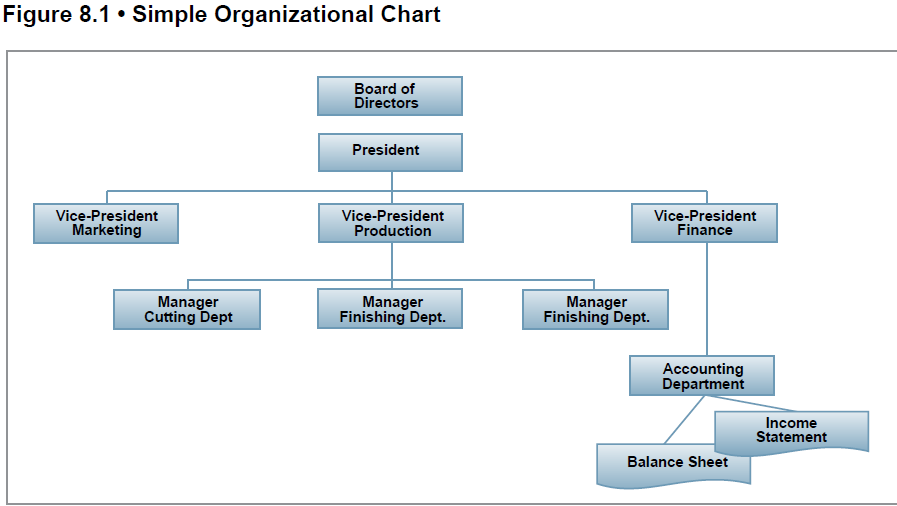

Slide 32
Budgeting and strategy
Strategic planning ‘precedes budgeting and provides the framework within which the annual budget is developed. A budget is, in a sense, a one-year slice of the organization’s strategic plan’ .

Slide 33
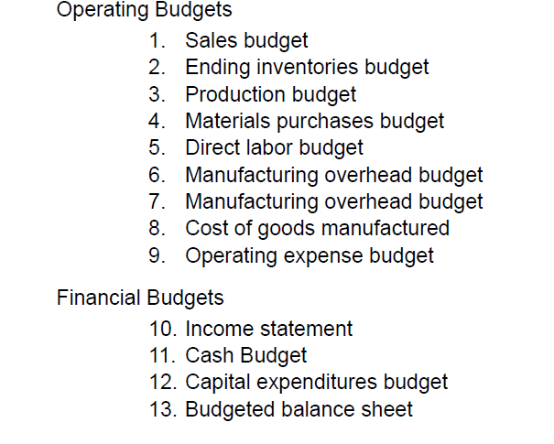
Components of the comprehensive budgeting

Slide 34
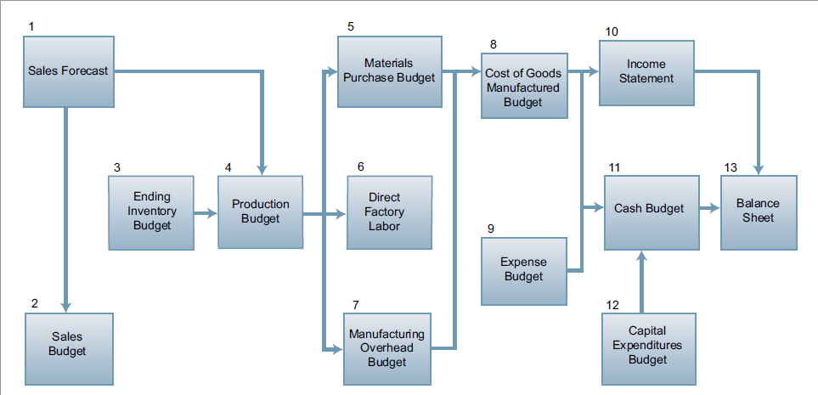

Slide 35
Purposes of budgeting
Implement strategy by allocating resources in line with strategic goals
Co-ordinate activities and assist in communication among different parts of an organisation
Motivate managers to achieve targets
Provide a means to control activities
Evaluate and business unit performance

Slide 36
Budget cycle
Identify business objectives
Forecast future conditions
  (1) general economic conditions, (2) industry trends, (3) market research studies, (4) anticipated advertising and promotion, (5) previous market share, (6) changes in prices, and (7) technological developments
Develop detailed sales budgets by market segments, major customers and product groups
Prepare production budgets for the goods or services needed to satisfy the sales forecast and maintain agreed levels of inventory.

Slide 37
Budget cycle (cont.)
Prepare expense budgets by cost centre
Prepare capital expenditure budgets
Prepare cash forecasts and identify financing requirements
Prepare master budget (Income Statement, Balance Sheet and Cash Forecast)
Obtain Board approval of profitability and financing targets

Slide 38
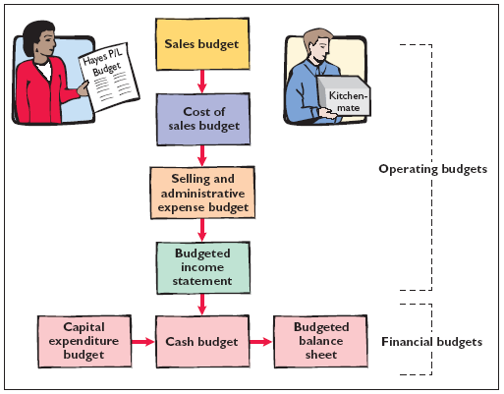
The Master Budget
The Master Budget is a set of interrelated budgets that constitutes a plan of action for a specified time period.

Slide 39
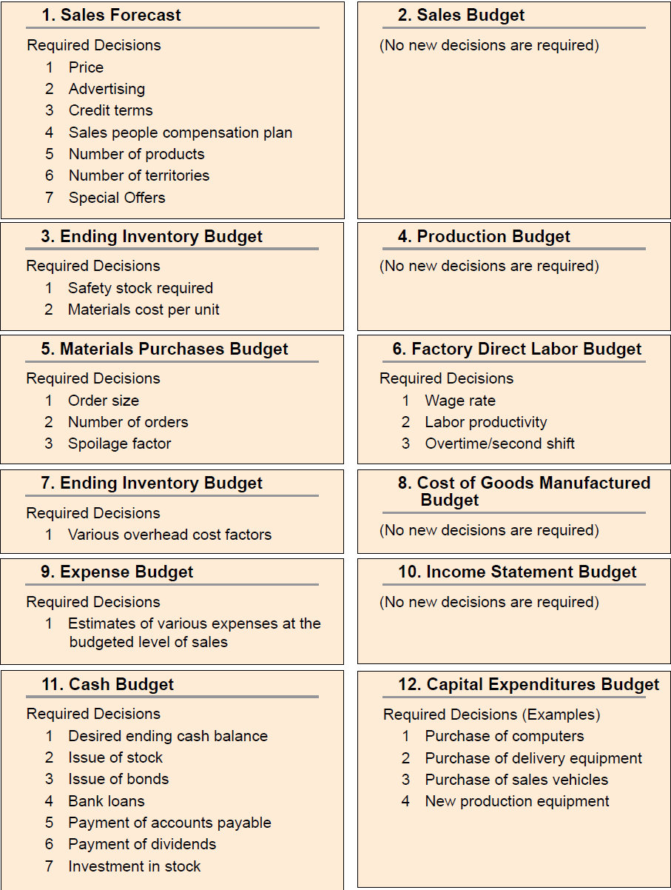

Slide 40
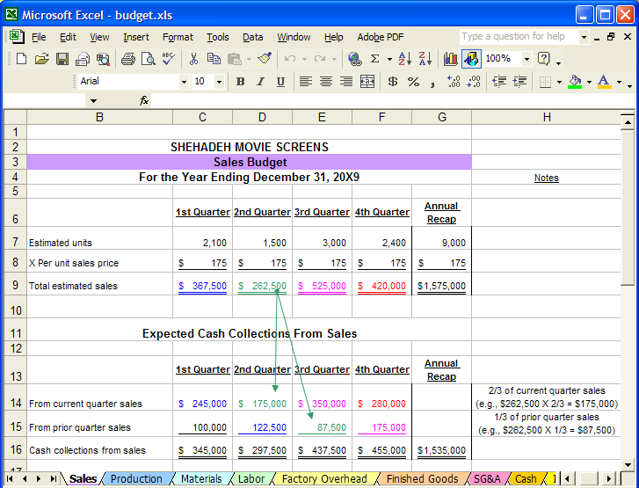
Formats of the operational and financial budgeting

Slide 41
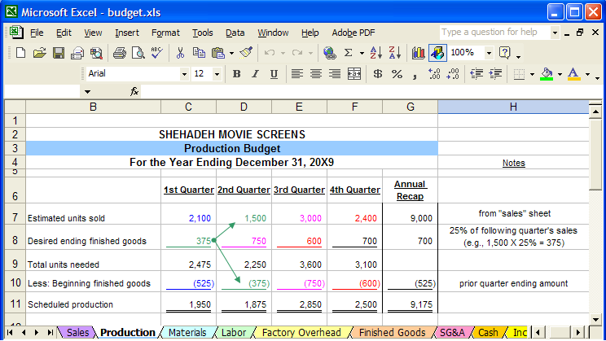
Production budget

Slide 42
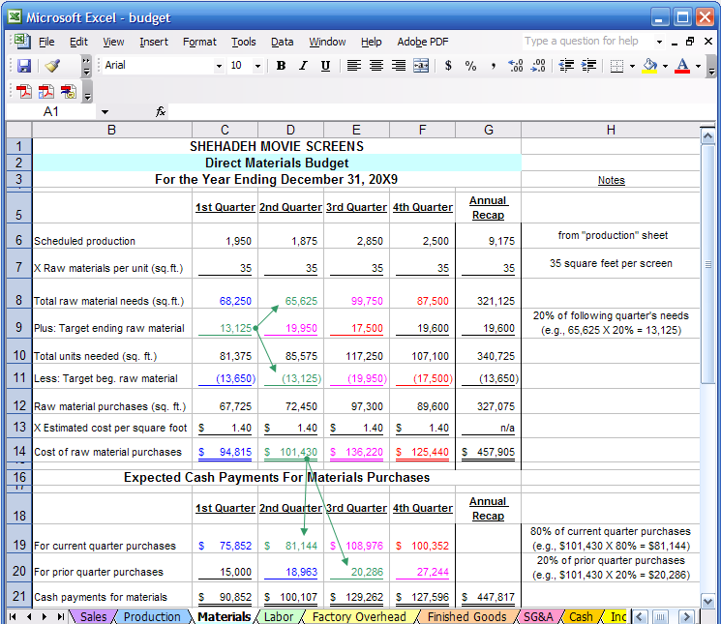
Material usage budget

Slide 43
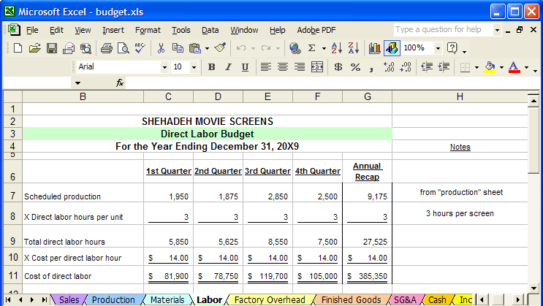
Labor budget

Slide 44
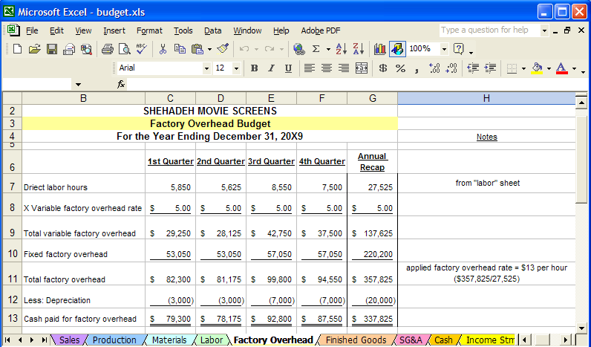
Factory overhead budget

Slide 45
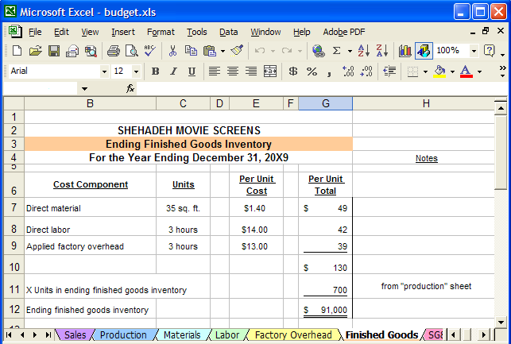
ENDING FINISHED GOOD INVENTORY BUDGET

Slide 46
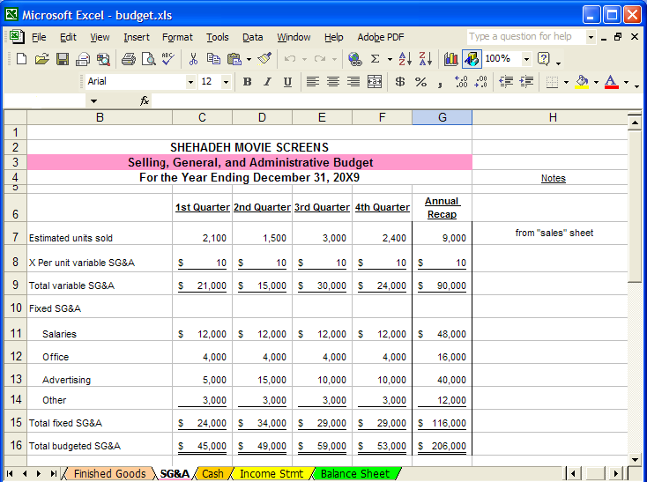
SELLING, GENARAL AND ADMINISTRATION BUDGET

Slide 47
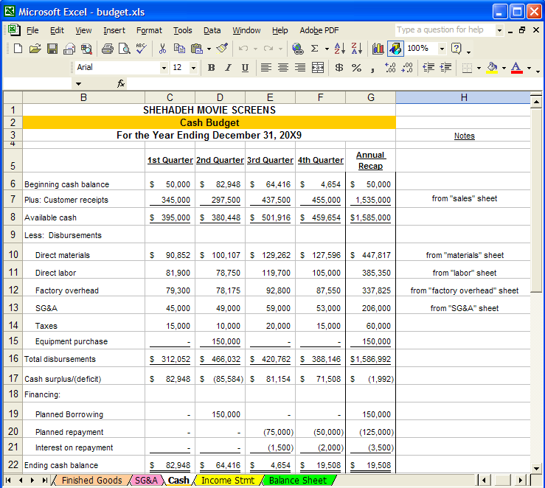
CASH BUDGET

Slide 48
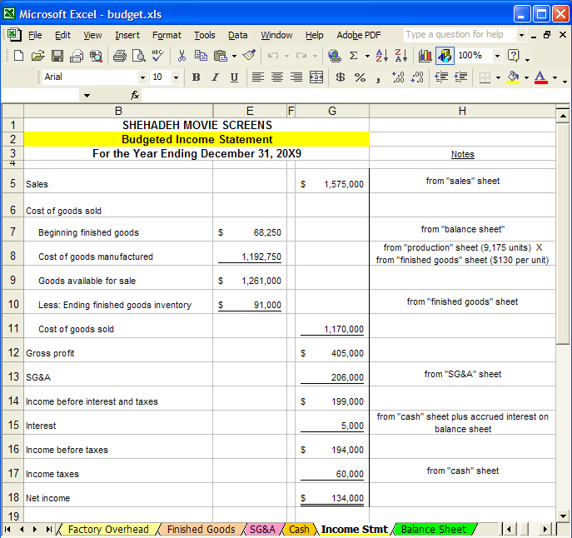
Budgeted income statement

Slide 49
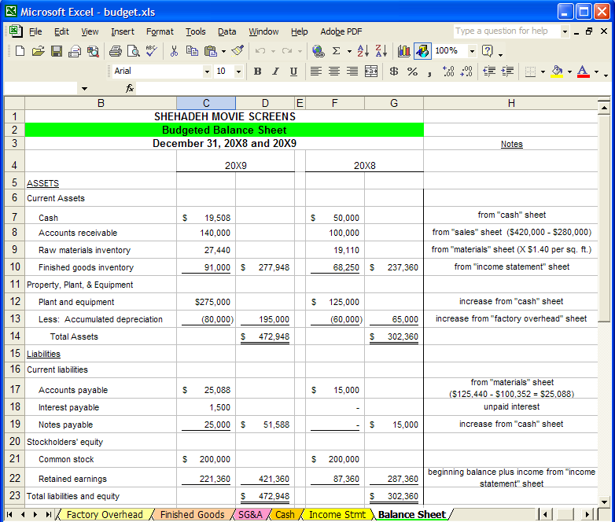
Budgeted balance sheet

